Slide 1
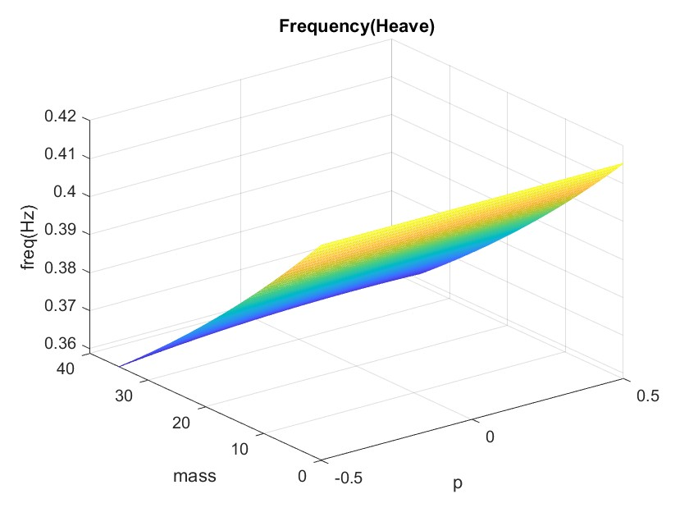
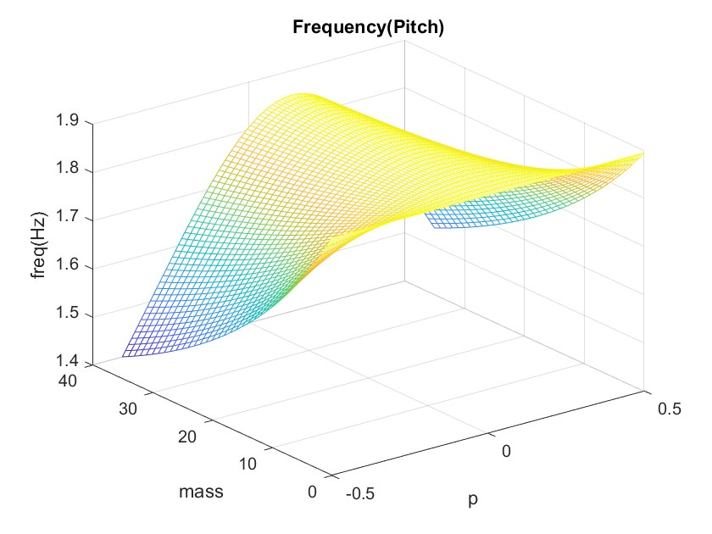
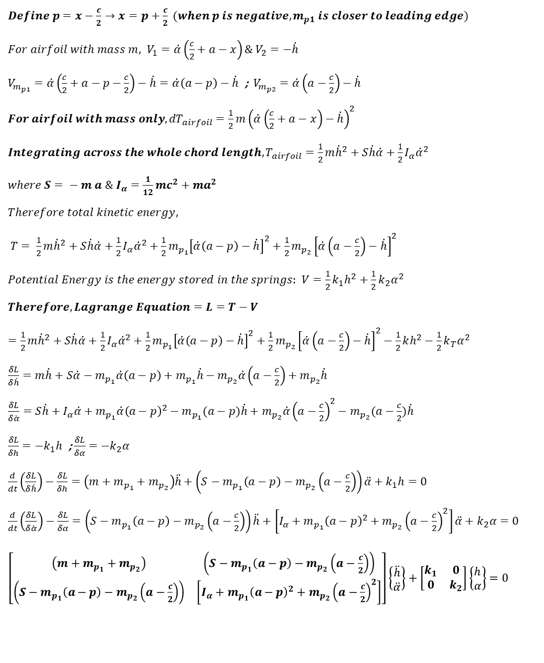
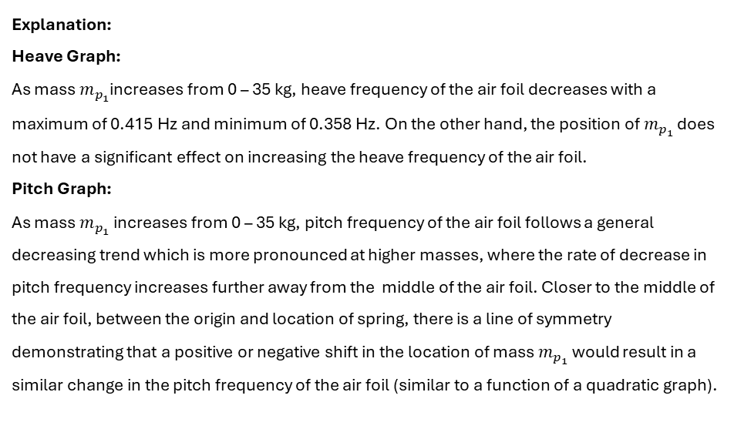
MA4704 Aeroelasticity – CA1 Seah Yong Le Stanley U212154F
Terms:
$c=1 m$ $; a=0.1 m$ $; k_{1}=750N m^{−1}$ $; k_{2}=1500N rad^{−1}$ ; $m=100 kg ; m_{p_{1}}=0−35kg ; m_{p_{2}}=10 kg$ ; $p=leading edge to trailing edge, with origin at 0$
$Define p=x−\frac{c}{2}→x=p+\frac{c}{2} (when p is negative, m_{p1} is closer to leading edge)$
$For airfoil with mass m, V_{1}=\dot{α}\left(\frac{c}{2}+a−x\right)\& V_{2}=−\dot{h}$
$V_{m_{p1}}=\dot{α}\left(\frac{c}{2}+a−p−\frac{c}{2}\right)−\dot{h}=\dot{α}\left(a−p\right)−\dot{h}$ ; $V_{m_{p2}}=\dot{α}\left(a−\frac{c}{2}\right)−\dot{h}$
$For airfoil with mass only, {dT}_{airfoil}=\frac{1}{2}m{\left(\dot{α}\left(\frac{c}{2}+a−x\right)−\dot{h}\right)}^{2}$
$Integrating across the whole chord length, T_{airfoil}=\frac{1}{2}m{\dot{h}}^{2}+S\dot{h}\dot{α}+\frac{1}{2}I_{α}{\dot{α}}^{2}$
$where S= − m a \& I_{α}=\frac{1}{12}mc^{2}+ma^{2}$
$Therefore total kinetic energy,$
$T= \frac{1}{2}m{\dot{h}}^{2}+S\dot{h}\dot{α}+\frac{1}{2}I_{α}{\dot{α}}^{2}+\frac{1}{2}m_{p_{1}}{\left[\dot{α}\left(a−p\right)−\dot{h}\right]}^{2}+\frac{1}{2}m_{p_{2}}{\left[\dot{α}\left(a−\frac{c}{2}\right)−\dot{h}\right]}^{2}$
$Potential Energy is the energy stored in the springs:$ $V=\frac{1}{2}k_{1}h^{2}+\frac{1}{2}k_{2}α^{2}$
$Therefore, Lagrange Equation=L=T−V$
$=\frac{1}{2}m{\dot{h}}^{2}+S\dot{h}\dot{α}+\frac{1}{2}I_{α}{\dot{α}}^{2}+\frac{1}{2}m_{p_{1}}{\left[\dot{α}\left(a−p\right)−\dot{h}\right]}^{2}+\frac{1}{2}m_{p_{2}}{\left[\dot{α}\left(a−\frac{c}{2}\right)−\dot{h}\right]}^{2}−\frac{1}{2}kh^{2}−\frac{1}{2}k_{T}α^{2}$
$\frac{δL}{δ\dot{h}}=m\dot{h}+S\dot{α}−m_{p_{1}}\dot{α}\left(a−p\right)+m_{p_{1}}\dot{h}−m_{p_{2}}\dot{α}\left(a−\frac{c}{2}\right)+m_{p_{2}}\dot{h}$
$\frac{δL}{δ\dot{α}}=S\dot{h}+I_{α}\dot{α}+m_{p_{1}}\dot{α}{\left(a−p\right)}^{2}−m_{p_{1}}(a−p)\dot{h}+m_{p_{2}}\dot{α}{\left(a−\frac{c}{2}\right)}^{2}−m_{p_{2}}(a−\frac{c}{2})\dot{h}$
$\frac{δL}{δh}=−k_{1}h$ ; $\frac{δL}{δα}=−k_{2}α$
$\frac{d}{dt}\left(\frac{δL}{δ\dot{h}}\right)−\frac{δL}{δh}=\left(m+m_{p_{1}}+m_{p_{2}}\right)\ddot{h}+\left(S−m_{p_{1}}\left(a−p\right)−m_{p_{2}}\left(a−\frac{c}{2}\right)\right)\ddot{α}+k_{1}h=0$
$\frac{d}{dt}\left(\frac{δL}{δ\dot{α}}\right)−\frac{δL}{δα}=\left(S−m_{p_{1}}\left(a−p\right)−m_{p_{2}}\left(a−\frac{c}{2}\right)\right)\ddot{h}+\left[I_{α}+m_{p_{1}}{\left(a−p\right)}^{2}+m_{p_{2}}{\left(a−\frac{c}{2}\right)}^{2}\right]\ddot{α}+k_{2}α=0$
$\left[\begin{matrix}\left(m+m_{p_{1}}+m_{p_{2}}\right) & \left(S−m_{p_{1}}\left(a−p\right)−m_{p_{2}}\left(a−\frac{c}{2}\right)\right) \\ \left(S−m_{p_{1}}\left(a−p\right)−m_{p_{2}}\left(a−\frac{c}{2}\right)\right) & \left[I_{α}+m_{p_{1}}{\left(a−p\right)}^{2}+m_{p_{2}}{\left(a−\frac{c}{2}\right)}^{2}\right]\end{matrix}\right]\left\{\begin{matrix}\ddot{h} \\ \ddot{α}\end{matrix}\right\}+\left[\begin{matrix}k_{1} & 0 \\ 0 & k_{2}\end{matrix}\right]\left\{\begin{matrix}h \\ α\end{matrix}\right\}=0$
Explanation:
Heave Graph:
As mass $m_{p_{1}}$increases from 0 – 35 kg, heave frequency of the air foil decreases with a maximum of 0.415 Hz and minimum of 0.358 Hz. On the other hand, the position of $m_{p_{1}}$ does not have a significant effect on increasing the heave frequency of the air foil.
Pitch Graph:
As mass $m_{p_{1}}$increases from 0 – 35 kg, pitch frequency of the air foil follows a general decreasing trend which is more pronounced at higher masses, where the rate of decrease in pitch frequency increases further away from the middle of the air foil. Closer to the middle of the air foil, between the origin and location of spring, there is a line of symmetry demonstrating that a positive or negative shift in the location of mass $m_{p_{1}}$ would result in a similar change in the pitch frequency of the air foil (similar to a function of a quadratic graph).
Explanation of Code:
Mass Matrix
Stiffness Matrix
Define all values
Loop values of p and m_{p1} across above matrix
Solve for eigenvalues which solves for pitch and heave

Slide 2
clear all
close all
% Defining Variables
k_1 = 750;
k_2 = 1500;
c = 1;
a = 0.1;
m = 100;
m_p2 = 10;
S = -m * a;
I_a = 1/12*m*c^2 + m*a^2;
i = 1;
for p = -c/2 : c/100 : c/2 %iterating through values of p with intervals of 0.01
j = 1;
for m_p1 = 0 : 1 : 35 %iterating though mass of m_p1 with intervals of 1
K = [k_1, 0; 0, k_2]; %stiffness matrix
A = m + m_p2 + m_p1;
B = S - m_p2*(a-c/2) - m_p1*(a-p);
C = S - m_p2*(a-c/2) - m_p1*(a-p);
D = I_a + m_p2*((a-c/2)^2) + m_p1*((a-p)^2);
M = [A B; C D];%mass matrix
omega_sq = eig(K,M);%solve for eigenvalue
omega = sqrt(omega_sq)/2/pi ;
freq_heave(i,j) = omega(1);
freq_pitch(i,j) = omega(2);
p_store(i,j) = p;
m_store(i,j) = m_p1;
j=j+1;
end
i=i+1;
end
%Plot Heave Frequency
figure
mesh(p_store,m_store,freq_heave)
xlabel('p')
ylabel('mass')
zlabel('freq(Hz)')
title('Frequency(Heave)')
%Plot Pitch Frequency
figure
mesh(p_store,m_store,freq_pitch)
xlabel('p')
ylabel('mass')
zlabel('freq(Hz)')
title('Frequency(Pitch)')

